Slide 1




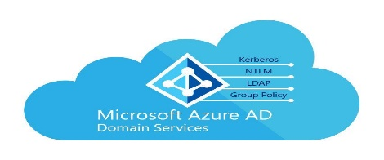









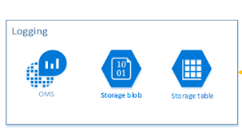



Microsoft Azure Govt
FS - Intranet
External System
1521:TCP
FMMI, NRM,
DOI, FPFS,
GDCII, ATSA
iSuite, FireCode,
Paycheck
Application Service - PaaS
PaaS: SQL Database
IBS HTTP Server
HTTPS
IBS Data Ex –
Broker & MWS
Internet Users
IBS Data Ex –
CentraSite
Intranet Users
CI / CD Tools
Code.fs.usda.gov
Virtual Network
GitHub Push

